Slide 1
Chapter 1: Stereochemistry

Slide 2
Unit description:
This unit deals with 3D aspects of molecules including (stereo)isomerism, chiralty, optical activity, enantiomers and diastereomers and meso compounds.

Slide 3
Unit learning outcomes:
Define stereochemistry
Explain isomerism in simple organic molecules
Explain the role of chirality in stereoisomerism
Describe enantiomers
Apply the R-S system in naming enantiomers
Outline the use of polarimeter (optical activity) in differentiating enantiomers
Outline resolution of enantiomers
Describe diastereomers
Describe meso compounds
Explain biological significance of stereoisomerism

Slide 4
Contents:
1.1. Introduction (Definition)
1.2. Isomerism (constitutional isomers, stereoisomerism, conformational and configurational isomers)
1.3. Chirality (Definition and methods to identify chiral center/molecules)
1.4. Enantiomers (Definition)
1.5. Naming enantiomers: The Cahn–Ingold–Prelog R–S notational system enantiomers,
1.6. Optical activity [observed and specific rotation])
1.7. Resolution of enantiomers
1.8. Diastereomers
1.9. Meso compounds
1.10. Biological significance of stereoisomerism

Slide 5
1.1. Introduction

Slide 6
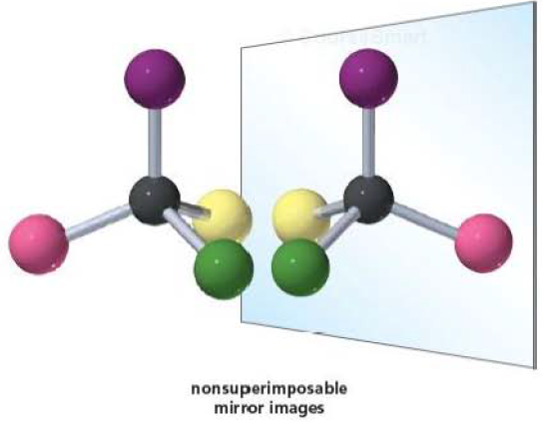
Stereochemistry
3D chemistry

Slide 7
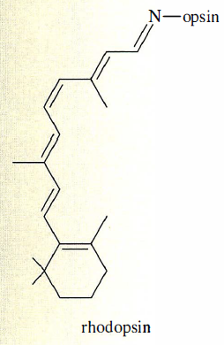
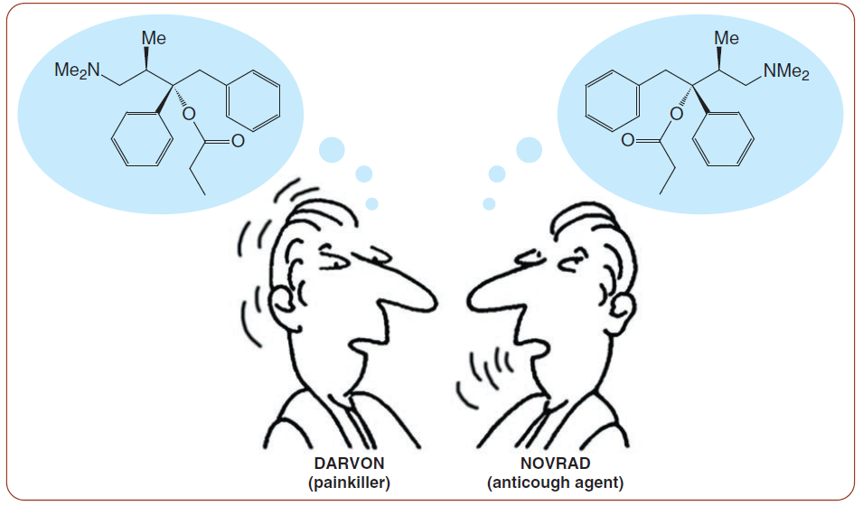
Biological action vs structure

Slide 8
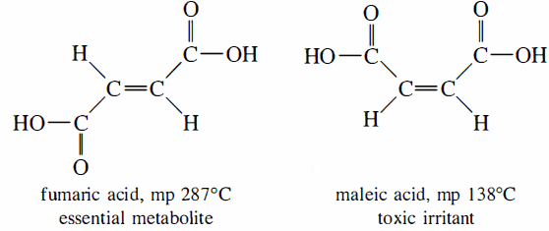
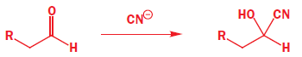
Physicochemical properties vs structure

Slide 9
1.2. Isomerism

Slide 10
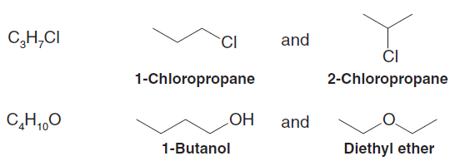
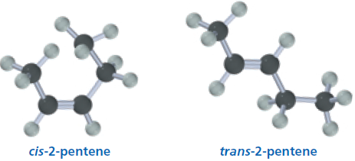
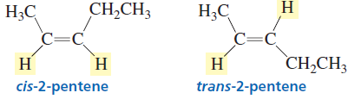
Isomers
“Made of the same parts”

Slide 11
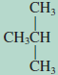
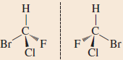
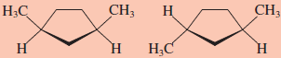
Classes of isomers
Isomers
Have the same molecular formula, but different structures
Constitutional isomers
Differ in the order of attachment of atoms (Connectivity)
Stereoisomers
Atoms are connected in the same order but differ in spatial orientation
Enantiomers
Image and mirror image are not superposable
Diastereomers
Not related as image and mirror image

Slide 12
1.2.1. Constitutional isomers

Slide 13
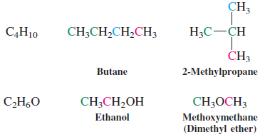
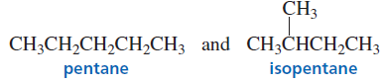
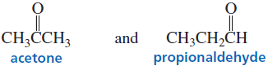
Sequence (connectivity) difference
Different compounds have entirely different physicochemical properties

Slide 14
1.2.2. Stereoisomerism

Slide 15
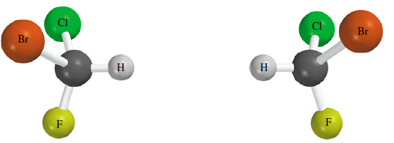
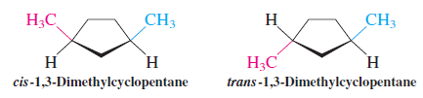
Same connectivity but different 3D structure

Slide 16
Two types of stereoisomers
Conformational isomers and
Configurational isomers

Slide 17
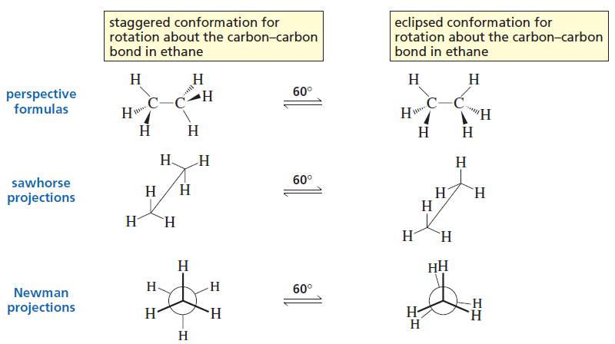
Conformational isomers
Example: Ethane

Slide 18
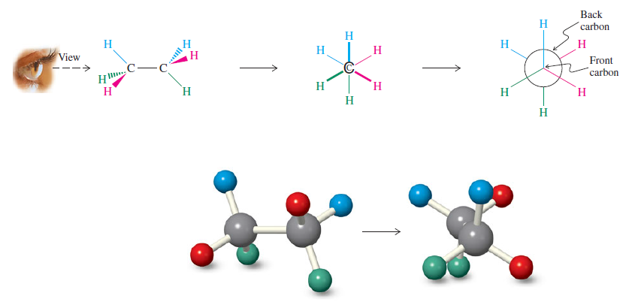
Newman projections

Slide 19
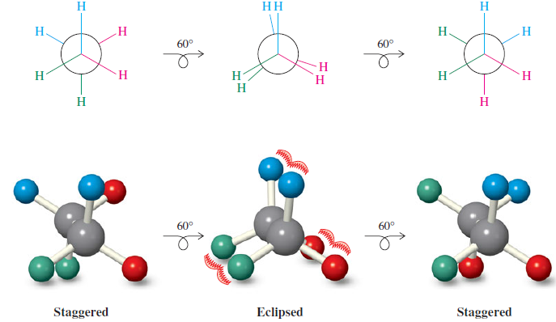
Rotation around single bond
Staggered vs Eclipsed

Slide 20
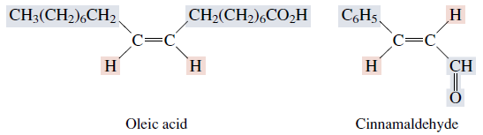
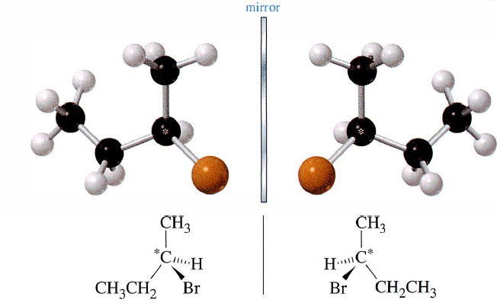
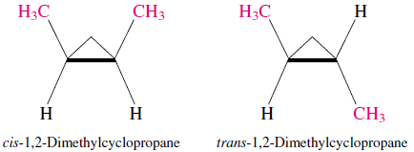
Configurational (stereochemical) isomers
Difference in spatial arrangement
Cannot be converted from one into another by rotations about single bonds

Slide 21
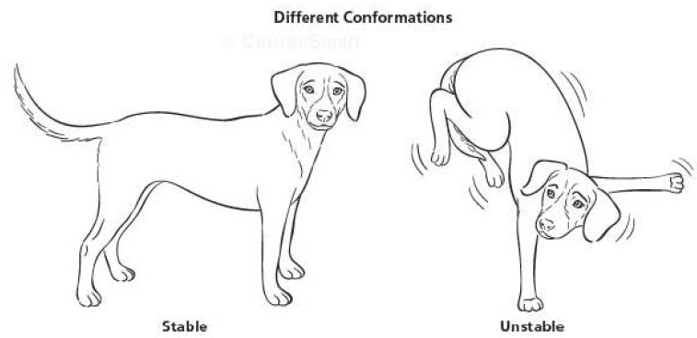
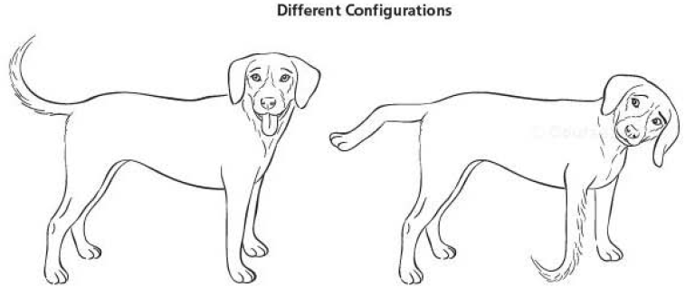
Summary
Conformational vs configurational isomers

Slide 22
1.3. Chirality

Slide 23
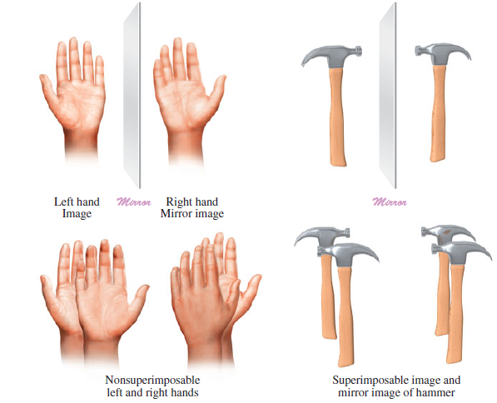
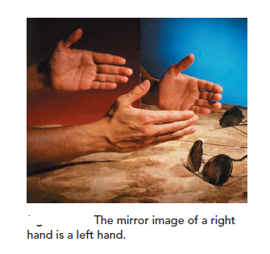
1.3. Chirality …
Chirality
The property of nonsuperimposability of an object on its mirror image

Slide 24
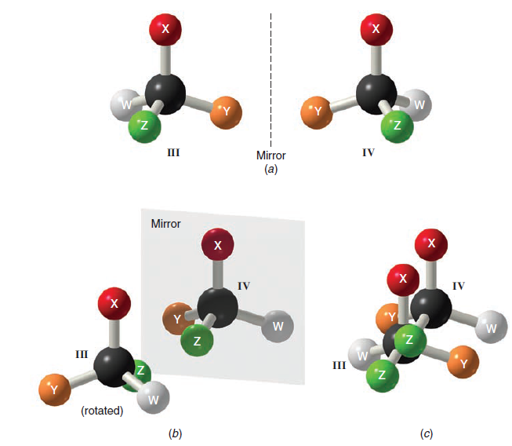
1.3. Chirality …
Chiral: a molecule is not superimposable on its
mirror image

Slide 25
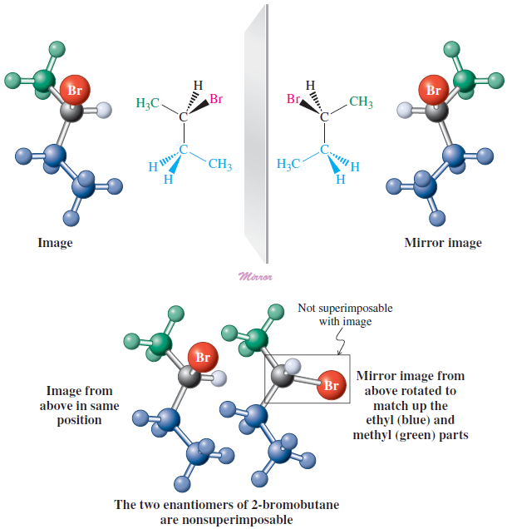
1.3. Chirality …

Slide 26
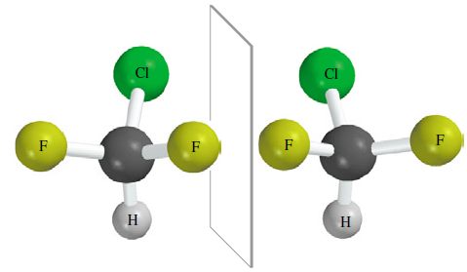
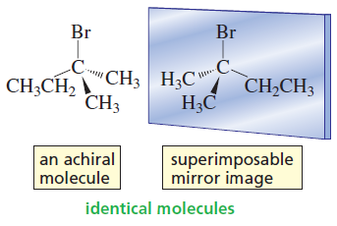
1.3. Chirality …
Achiral: superimposable on its mirror image

Slide 27
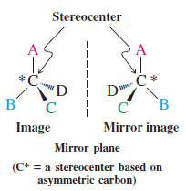
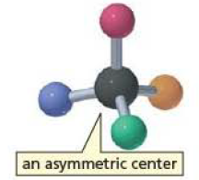
1.3. Chirality …
Stereocenters, chirality center, or asymmetric carbons
The most common cause for chirality

Slide 28
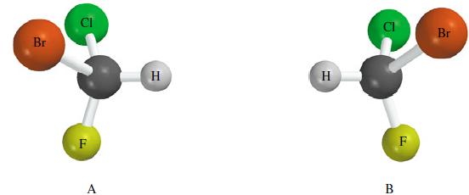
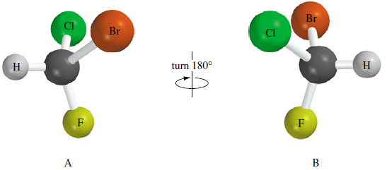
1.3. Chirality …
Example 1: bromochlorofluoromethane (BrClFCH)
Mirror
To test for superposability, reorient B by turning it 180°.

Slide 29
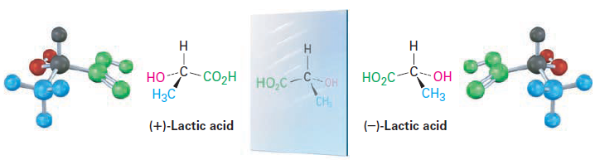
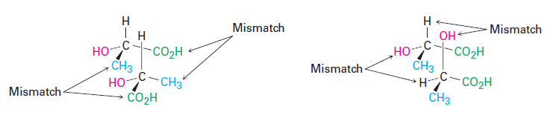
1.3. Chirality …
Example 2: Lactic acid

Slide 30
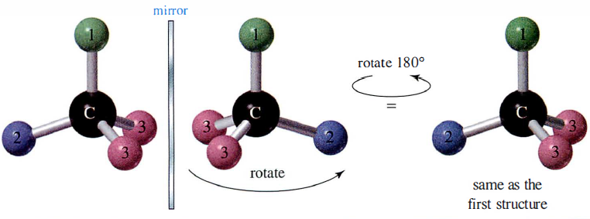
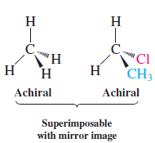
1.3. Chirality …
Example 3: achiral molecule

Slide 31
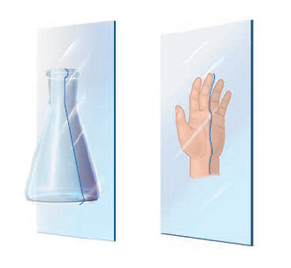
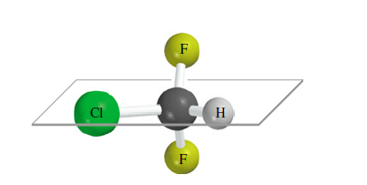
1.3. Chirality …
Test for chirality
Plane of symmetry

Slide 32
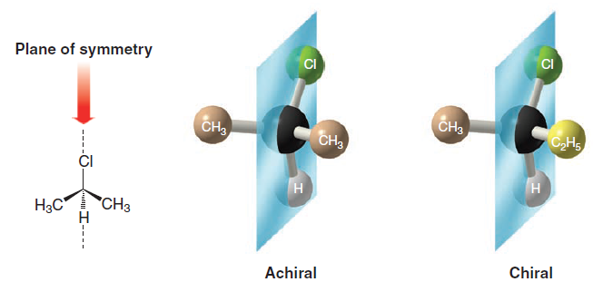
1.3. Chirality …
Example 1:

Slide 33
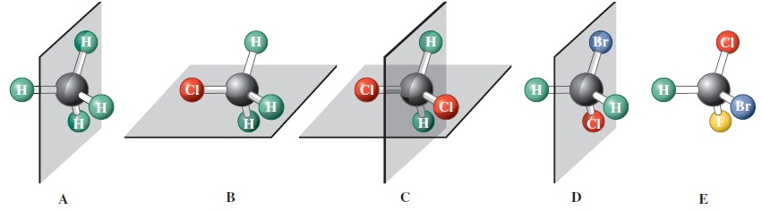
1.3. Chirality …
Example 2:

Slide 34
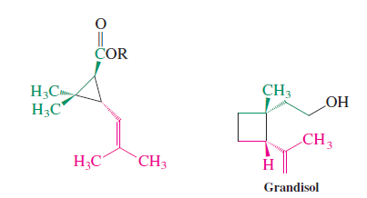
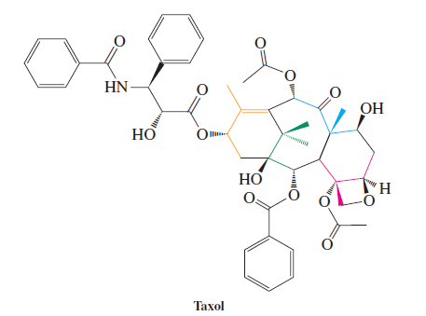
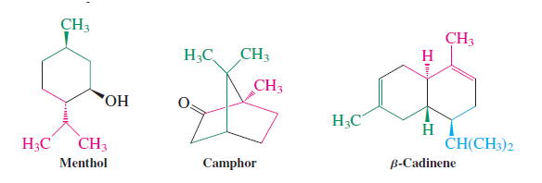
1.3. Chirality …
Exercise:
Among the natural products shown below, which are chiral and which are achiral?
Give the number of stereocenters in each case.

Slide 35
1.4. Enantiomers

Slide 36
1.4. Enantiomers …
Classes of isomers
Isomers
Have the same molecular formula, but different structures
Constitutional isomers
Differ in the order of attachment of atoms (Connectivity)
Stereoisomers
Atoms are connected in the same order but differ in spatial orientation
Enantiomers
Image and mirror image are not superposable
Diastereomers
Not related as image and mirror image

Slide 37
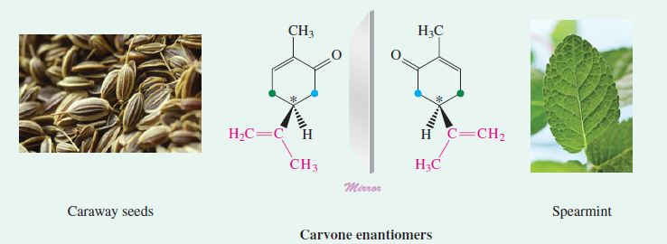
1.4. Enantiomers …
Enantiomers
Molecules that are non‒superimposable mirror images of each other

Slide 38
1.4. Enantiomers …
If a molecule is nonsuperimposable on its mirror image, the mirror image must be a different molecule.
Therefore, differ in structure only in the left and right handedness of their orientations.
Have same physicochemical properties, except:
Optical activity
Interaction with chiral molecules

Slide 39
1.4. Enantiomers …
Pharmacological properties
Only one enantiomer is active
Both enantiomers show essentially identical activities:
Both enantiomers have similar activity, but one enantiomer is more active;
Enantiomers show different pharmacological activities

Slide 40
1.5. Naming enantiomers: The Cahn–Ingold–Prelog R–S notational system

Slide 41
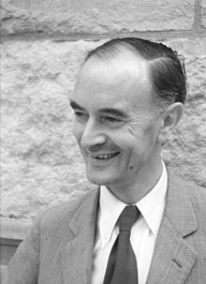
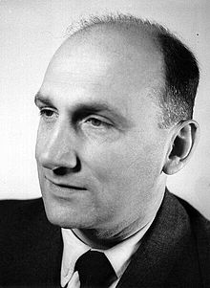
1.5. Naming enantiomers…
Developed by R. S. Cahn, C. Ingold, and V. Prelog
Christopher Kelk Ingold
Vladimir Prelog

Slide 42
1.5. Naming enantiomers…
Steps:
1. Locate the chiral center and identify the substituents on the
chiral center

Slide 43
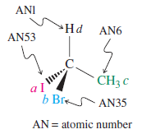
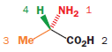
1.5. Naming enantiomers…
2. Assign a priority (i.e. 1, 2, 3 or 4) or preference (i.e. a, b, c, or d)
I> Br > Cl > S > F > O > N > ^{l3}C> ¹²C > Li > ³H > ²H > ¹H

Slide 44




1.5. Naming enantiomers…
Groups tied?
Example:

Slide 45
1.5. Naming enantiomers…
Example:
2-Iodobutane and 3-Ethyl-2,2,4-trimethylpentane

Slide 46

1.5. Naming enantiomers…
Double and triple bonds

Slide 47
1.5. Naming enantiomers…
Double and triple bonds
Exercise: Give priority

Slide 48

1.5. Naming enantiomers…
3. Arrange the molecule so that the lowest priority substituent is pointing away from you.

Slide 49



1.5. Naming enantiomers…
4. Mentally move from substituent priority 1 to 2 to 3.

Slide 50

1.5. Naming enantiomers…

Slide 51
1.5. Naming enantiomers…
Example: Serine

Slide 52



1.5. Naming enantiomers…
Exercise
Identify each chiral center as (R)- or (S)-

Slide 53
1.6. Optical activity

Slide 54
1.6. Optical activity …
Enantiomers
Similar physicochemical properties
Except interaction with plane polarized light
Compound | Boiling Point (bp) or Melting Point (mp)
(R)-2-Butanol | 99.5°C (bp)
(S)-2-Butanol | 99.5°C (bp)
(‒)-(R,R)-Tartaric acid | 168–170°C (mp)
(‒)-(S,S)-Tartaric acid | 168–170°C (mp)
(+/‒)-Tartaric acid | 210–212°C (mp)

Slide 55


1.6. Optical activity …
Light

Slide 56



1.6. Optical activity …
Polarizer
Interacts with the electric field component of light
Plane-polarized light

Slide 57

1.6. Optical activity …
Polarimeter
Optical rotation

Slide 58

1.6. Optical activity …
If rotation is
Clockwise: (+); dextrorotatory
Counterclockwise: (‒); levorotatory

Slide 59
1.6. Optical activity …
Observed rotation (α)
Is the angle through which a sample of a compound (usually a solution) rotates plane-polarized light
Depends on:
path length
concentration,
temperature,
solvent, and
wavelength

Slide 60
1.6. Optical activity …
Specific for each optically active compound
The specific rotation ([α]^{T}_{λ} (solvent))
“is the number of degrees of rotation caused by a solution of 1.0 g of the compound per mL of solution in a sample tube 1.0 dm long at a specified temperature and wavelength”

Slide 61
1.6. Optical activity …
Hence, specific rotation ([α]^{T}_{λ} (solvent)) is defined as:
Example:
When 0.300 g of sucrose is dissolved in 10.0 mL of water and placed in a sample cell 10.0 cm in length, the observed rotation is +1.99° (using the D line of sodium at 20°C). Calculate the specific rotation of sucrose.

Slide 62
1.6. Optical activity …
Given:
α = +1.99°
0.300 g in 10 ml c = 0.300 g/10.0 mL = 0.03 g/mL
l = 10 cm = 1 dm
Required:
Solution:

Slide 63

1.6. Optical activity …
Racemic mixtures
Mixtures containing equal quantities of enantiomers
α is zero

Slide 64
1.6. Optical activity …
Optical activity of a sample: ratio of enantiomers
If only one enantiomer present
Optically pure, or enantiomerically pure
If equal
Racemic
One in excess
Net rotation
Enantiomer excess (ee)

Slide 65
1.6. Optical activity …
Enantiomer excess (ee)
tells us how much of excess of one enantiomer is in the mixture:
Or

Slide 66
1.6. Optical activity …
Example:
A solution of (+)-alanine from a fossil exhibits a value of [α] = 4.25.
What is its ee and optical purity?
What is the actual enantiomer composition of the sample, and how is the measured optical rotation derived from it?
The specific rotation of pure (+)-alanine is + 8.5

Slide 67
1.6. Optical activity …
Given:
α_{o}= + 4.25
α_{s}= + 8.5
Required: i. ee ii. Actual composition iii. α_{o}= 0.5 α_{s}
Solution
% ee
75% (+)- and 25% (‒)-alanine
α_{o}= 0.5 α_{s}

Slide 68
1.7. Resolution of enantiomers

Slide 69

1.7. Resolution…
Nature:
Pure enantiomers

Slide 70


1.7. Resolution…
Laboratory synthesis from achiral reagents
Racemate

Slide 71
1.7. Resolution…
Resolution
The separation of a racemic mixture into its enantiomeric components
How?
Reaction with pure enantiomer
Enzymes
Chiral chromatography

Slide 72

1.7. Resolution…
Reaction with pure enantiomer: formation of diastereomers

Slide 73
1.8. Diastereoisomers

Slide 74


1.8. Diastereoisomers …
Diastereoisomers (diastereomers)
Stereoisomers that are not mirror images of one another
Are either
Geometric isomers
Compounds containing two or more chirality centers

Slide 75

1.8. Diastereoisomers …
Different physicochemical properties
Notes:
2,3-dihydroxybutanoic acids

Slide 76
1.8.1. Geometric isomers

Slide 77



1.8.1. Geometric…
Geometric isomers (cis-trans isomers)
Exist due to hindred rotation about a bond
Ring structure

Slide 78




1.8.1. Geometric…
Presence of multiple bonds

Slide 79
1.8.1. Geometric…
Examples of drugs with geometric isomerism

Slide 80
1.7.2. Isomers with more than one asymmetric carbon (chiral centers)

Slide 81

1.7.2. Isomers with…
Molecules with many stereocenters
How many stereocenters cholesterol has?

Slide 82


1.7.2. Isomers with…
For a molecule with n sterocenters
2^{n} stereoisomers (not always. Why?)
Example:
2-Bromo-3-chlorobutane
2 stereocenters
2² = 4 stereoisomers

Slide 83

1.7.2. Isomers with…
Another example: 2-Bromo-3-chlorobutane

Slide 84

1.7.2. Isomers with…
One more natural example: ephedrine

Slide 85
1.8. Meso compounds

Slide 86

1.8. Meso…

Slide 87


1.8. Meso…
Meso compounds
Compounds that are achiral, yet contain chirality centers
How to check?
Plane of symmetry?
Best example: tartaric acid
two stereocenters; 4 stereoisomers ????

Slide 88

1.8. Meso…
Why only three?

Slide 89


1.8. Meso…
But the 2R,3S and 2S, 3R really enantiomers?
No!!!!

Slide 90
1.10. Biological significance of stereoisomerism

Slide 91
1.10. Biological…
Drugs as well as other biological compounds
Show stereoiosmerism
One enantiomeric form of a drug may be active, and the other may be
inactive,
less active or
even toxic.

Slide 92

1.10. Biological…
Examples:
Ibuprofen

Slide 93

1.10. Biological…
Limonene

Slide 94




1.10. Biological…
Thalidomide
The Thalidomide Tragedy: 1961

Slide 95

1.10. Biological…
Further examples

Slide 96


1.10. Biological…
Why do enantiomers have different biological properties?
Most of the molecules that make up living organisms are chiral

Slide 97


